Slide 1

Examples Architectures
Prepared by
POTTURI SRIRAM
Y20AIT490

Slide 2
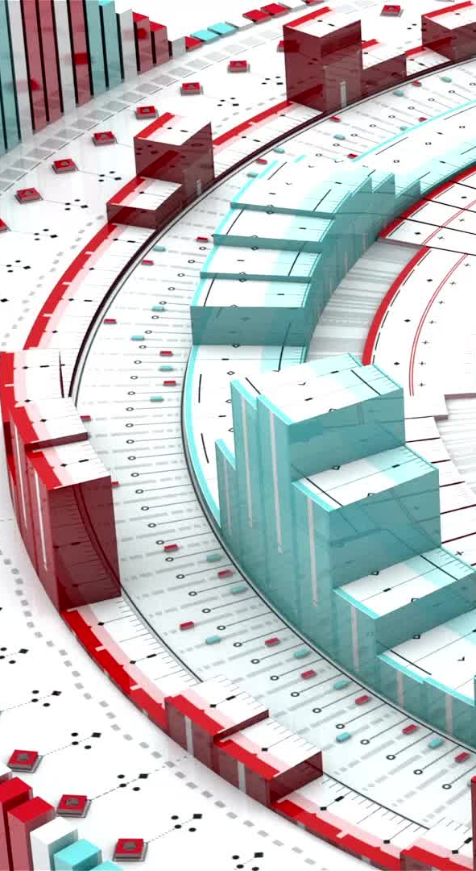
Introduction
Welcome to our presentation on "Examples of Architectures." Today, we will explore two fundamental architectural paradigms in the world of distributed computing.
Our discussion will revolve around the Network File System (NFS) and the architecture of the World Wide Web (the Web).
Both these examples offer unique insights into how distributed systems operate and interact, showcasing the power of well-designed architectures in the digital age.

Slide 3
Network File System (NFS)
NFS, or Network File System, is a protocol that enables remote file access and sharing in distributed computing environments. It allows a user to access files and directories on a remote server as if they were on a local machine, facilitating seamless data sharing and storage in a networked environment.
NFS plays a crucial role in sharing files and resources in distributed computing by providing a standardized method for accessing data across different systems and platforms. It simplifies data sharing, centralizes file storage, and enhances collaboration and resource utilization in networked environments, fostering efficiency and scalability in various applications and industries.

Slide 4
NFS Architecture
1. Client-Server Model: NFS operates using a client-server architecture where the client (requesting system) can access files and resources on the server (storage system) over the network.
2. NFS Protocol: NFS relies on a well-defined protocol for communication, allowing clients to send requests and servers to respond with the requested file data or operations. This protocol ensures seamless file sharing and management across distributed systems.

Slide 5
Use Cases of NFS
Data Storage and Backup: NFS is used for centralized data storage and backup solutions, enabling multiple clients to access and back up their data on a network-attached server.
Content Delivery: It's utilized in content delivery networks (CDNs) to distribute media files efficiently to users worldwide.
Virtualization: NFS is integral to virtualization platforms, allowing virtual machines to access shared data and configuration files.
Software Development: Developers often use NFS to share source code and project files across teams, ensuring version control and collaboration.
Scientific Computing: NFS aids in collaborative research by providing a common file system for sharing and analyzing large datasets in scientific computing.

Slide 6
Benefits of NFS
1. Centralized File Management: NFS centralizes file storage and management, making it easier to organize, backup, and secure data.
2. Efficient Resource Sharing: It enables efficient resource sharing across a network, reducing redundancy and promoting collaboration in distributed computing environments.
3. Platform Independence: NFS is platform-independent, allowing various operating systems to access and share files seamlessly.
4. Simplified Maintenance: NFS simplifies system maintenance and updates by providing a single point for managing files and resources.

Slide 7
Challenges in NFS
Security: NFS traditionally lacks robust security features, making data vulnerable to unauthorized access and tampering without additional measures.
Data Consistency: NFS may face data consistency issues when multiple clients access and modify the same files simultaneously, potentially leading to conflicts and data corruption.
Network Dependency: NFS performance is highly dependent on network stability; disruptions can affect file access and resource sharing.
Cross-Platform Compatibility: Ensuring compatibility and interoperability between different operating systems can be challenging when using NFS.

Slide 8
The Web Architecture
The World Wide Web (WWW) follows a client-server architecture. Clients, typically web browsers, request web pages and content from web servers. This architecture enables the distribution of information and services across a globally interconnected network, forming a fundamental component of distributed systems. It allows users to access and share resources, information, and applications seamlessly over the internet, fostering a vast and interconnected digital ecosystem.

Slide 9
Client-Server Model
The client-server architecture is the foundation of the web. In this model, clients (e.g., web browsers) request services or data from servers (e.g., web servers). Servers store and manage web content, responding to client requests. This architecture enables efficient distribution of web resources, centralizes data, and facilitates a scalable and accessible system for users to retrieve and interact with information online.

Slide 10
Protocols and Standards
HTTP (Hypertext Transfer Protocol): It governs data communication between web clients and servers, allowing the retrieval and display of web content.
HTTPS (Hypertext Transfer Protocol Secure): It is a secure version of HTTP, encrypting data to protect privacy and security.
HTML (Hypertext Markup Language): It's a standard for structuring and presenting web content, defining the layout and elements of web pages, ensuring consistency and readability.

Slide 11
Components of the Web
Web Servers: These store and serve web content, responding to client requests and managing data, often using HTTP or HTTPS.
Web Browsers: Clients such as Chrome, Firefox, and Safari, render and display web pages by retrieving and interpreting HTML, CSS, and JavaScript.
Content Delivery Networks (CDNs): They optimize content delivery by distributing it across multiple servers geographically, reducing latency and enhancing performance for users accessing web resources.

Slide 12
Use Cases of the Web
E-commerce: Websites like Amazon use web servers to offer product information, shopping carts, and secure transactions, with browsers rendering pages for users.
Social Media: Platforms like Facebook employ web servers to store and share user-generated content, while browsers enable users to access their profiles and interact with others, all built on web architecture.

Slide 13
Benefits of the Web
Global Accessibility: The web provides information and services to users worldwide, bridging geographical boundaries and enabling universal access.
Efficient Information Sharing: It allows rapid and cost-effective dissemination of data, enabling businesses, individuals, and organizations to share information, collaborate, and communicate seamlessly.

Slide 14
Challenges in the Web
Security: The web is susceptible to cybersecurity threats like data breaches and hacking, requiring robust security measures to protect user data and privacy.
Scalability: As web traffic and user demands grow, maintaining a scalable infrastructure to handle increased loads becomes challenging, necessitating effective scalability solutions.

Slide 15
Conclusion
The presentation highlights the significance of architectural examples in understanding distributed systems. By examining real-world instances like client-server models in web architecture, NFS in file sharing, and CDNs in content delivery, we can grasp the practical applications and challenges of distributed systems. These examples demonstrate the vital role of architectural choices in shaping the functionality, efficiency, and security of distributed systems, showcasing their impact on various domains, from web services to data sharing and beyond.

Slide 16

.
THANKING YOU

